Slide 1
Distinguish Real News and Fake News
Our Team: Siyuan Ni, Wenbo Yang, Junzhe Yu, Quanyin Yu, Kuochang Lan

Slide 2

Table of Contents
01
Problem Statement
02
Technical Implementation
03
Business Recommendation

Slide 3
Problem Statement
01
Problem Background
Available Data
Goal & Deliverable
Project Structure

Slide 4
Problem Background
When the social platform becomes the hub of fake news and conspiracy theories, the company reputation will be damaged and it will face numerous financial and legal problems. It is impossible to ask viewers to think critically about every post they read so the responsibility should fall on the platform itself.
How can we distinguish fake news from real news in online posts quickly and accurately?

Slide 5
Available Data
Title
Subject
Text
Date
The title of the post
The subject (category) of the post
Kaggle Data
The content in the post
The date of the post
2 datasets (fake.csv & real.csv, 100MB+)
https://www.kaggle.com/clmentbisaillon/fake-and-real-news-dataset?select=True.csv

Slide 6
Goal & Deliverable
Short-term Goal
Long-term Goal
Deliverable
A predictive tool to distinguish fake news from real news in the given data sets
A business pipeline to identify fake news at real scale in real time
Presentation &
Prediction Models in Jupyter Notebook

Slide 7
Project Structure
Summary
Next
Audience
VP of Operations & DS Team at Twitter
Automatic tool to distinguish fake news from real news
Foundation for future NLP machine learning studies
Knowledge about evaluation of real news and fake news
Strategies to educate news agencies about news authenticity
Purpose
Offer a predictive tool to distinguish fake news from real news
Content
Independent variables:
variables converted from raw texts
Dependent variables:
whether the news is fake
Challenge
Create features & Improve accuracy

Slide 8
Technical Implementation
02
Model:
Data Preparation
Model Objective
Baseline Model
Advanced Model
Topic Modeling
Summary & Reflection

Slide 9
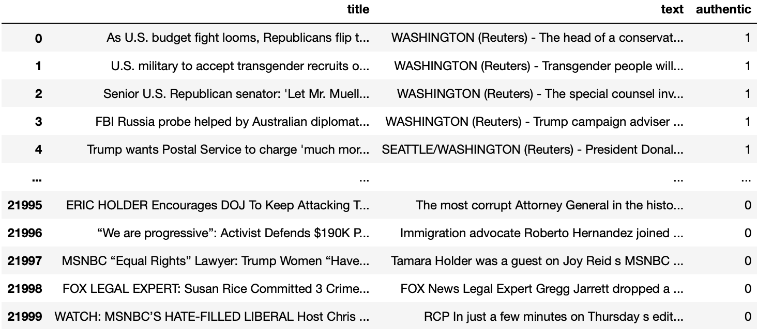
Data Preparation
Step 1 Merge Datasets
Merge fake.csv and real.csv and create a dummy variable (authentic) to label whether the news is fake or real for every news

Slide 10
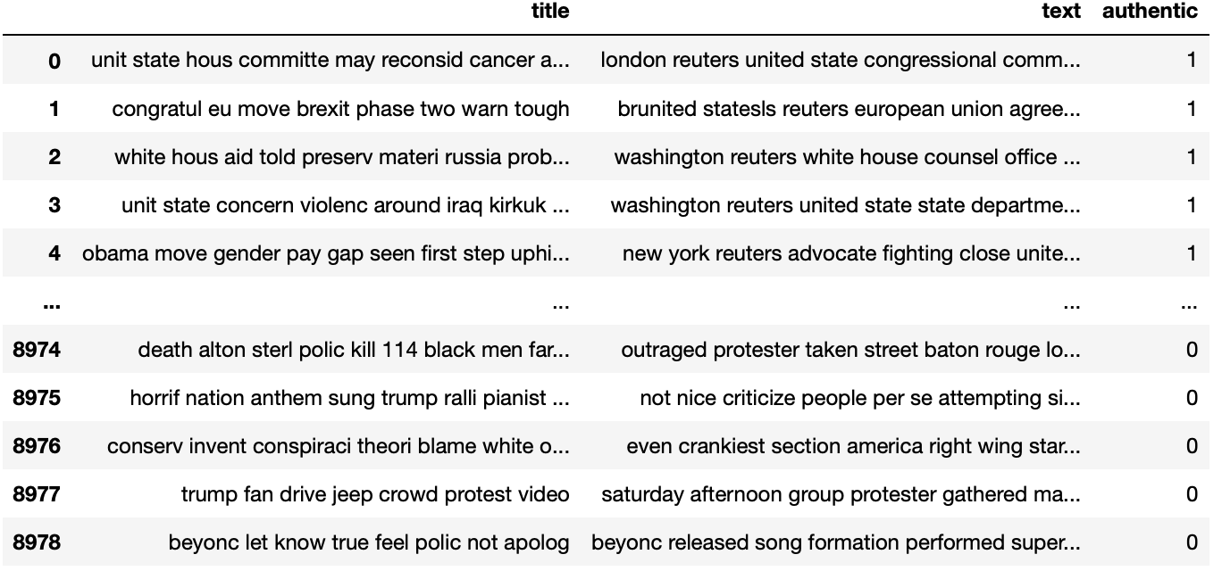
Data Preparation
Step 2 Text Processing
Perform multiple regex cleaning, stopwords removal and stemming on the original news and generate a new csv file with cleaned data

Slide 11
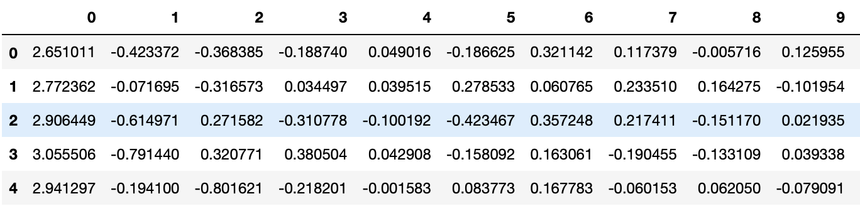
Data Preparation
Step 3 Feature Engineering
Using word2vec and dimension reduction to create 30 numerical variables for each row

Slide 12
Model Objective
Evaluation Metrics
Prediction Period
We use various metrics to evaluate model performance:
accuracy
ROC_AUC score
The data set includes news posts from 2017 to 2019

Slide 13
Baseline Model
Model
Result
Algorithm 1
Logistic Regression
Roc-auc score | 0.952
Accuracy | 0.951
Algorithm 2
Random Forest
Roc-auc score | 0.927
Accuracy | 0.927

Slide 14
Advanced Model - LSTM
Summary
Result
Algorithm
LSTM
Title Column:
Processing
First use “title” column for the model, but the result is not good, so “text” column is applied for the model
Accuracy | 0.916
Text Column:
Parameters
epoch = 10
validation_split = 0.3
num_words = 20000
max__sequence_length = 300
Test accuracy | 0.974
CV accuracy | 0.971

Slide 15
Advanced Model - RNN
Summary
Result
Algorithm
RNN
Title Column:
Processing
First use “title” column for the model, but the result is not good, so “text” column is applied for the model
Accuracy | 0.882
Text Column:
Parameters
epoch = 10
validation_split = 0.3
num_words = 10000
max__sequence_length = 1000
Accuracy | 0.921

Slide 16
Topic Modeling
Step
Finding
Vectorization
Vectorize the corpus with TF-IDF
Presidential election is one of the most common topic in those news, both real news and fake news
Frequent real news topics include military news and government announcements
Frequent fake news topics include those with the word subscribe
Fit
Fit the data with NMF model
Report
Offer separate reports for both real news and fake news

Slide 17
Summary & Reflection
The LSTM model is the best among multiple models, and it performs well in the news authenticity classification, with accuracy rate higher than 0.97.
Model result
We can try additional datasets to see how scalable the model is, and with additional time, we can perform additional data processing
Suggestion for future models
Fake news more likely to mention “subscribe” than real news news and related to news of 2016 presidential election, Hillary Clinton is more likely to be mentioned than Donald Trump in the fake news. Yet, those suggestions are inconclusive.
Findings in topic modeling

Slide 18
Roadmap
Model Validation
Model Insights
Business Production
Model Improvement
Vigorously improve model accuracy
Align the findings with multiple departments
Perform the model in the Twitter server with automatic pipeline
Monitor and improve the model effectiveness regularly

Slide 19
Business Recommendation
03
Roadmap
Benefits & Risks

Slide 20
Benefits & Risks
1. We now have an accurate automatic model to distinguish fake news from real news
2. We have some understanding about the topics related to fake news or real news
Benefits
Risks
1. The model only detects the authenticity of news but might unable to correctly distinguish between real posts from fake posts when the content is short than regular news
2. We do not have an additional step to confirm the model accuracy or correct the mistaken prediction in the real business setting

Slide 21
Do you have any questions?
THANKS

